Slide 1
What is Sora?
Sora is the best way to access ebooks and audiobooks from the school’s community digital collection.
soraapp.com
or download the app

Slide 2
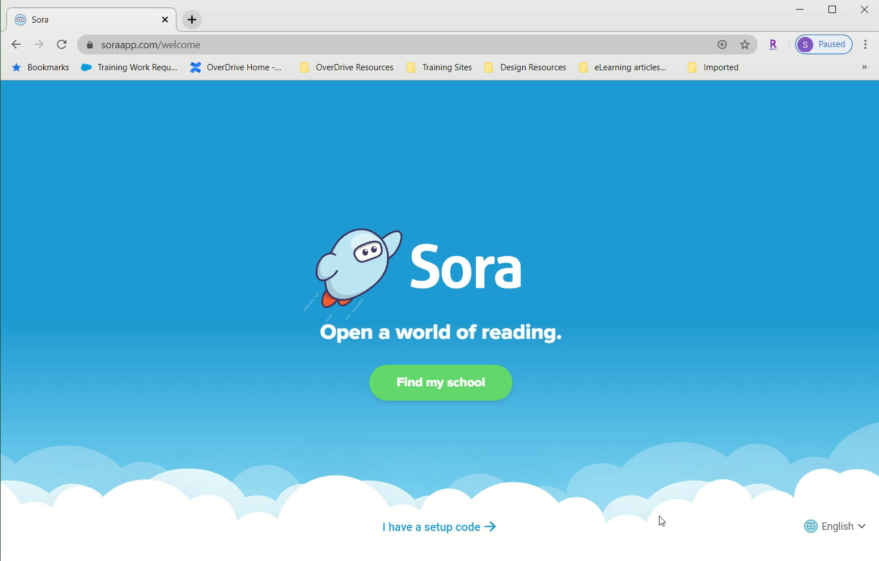
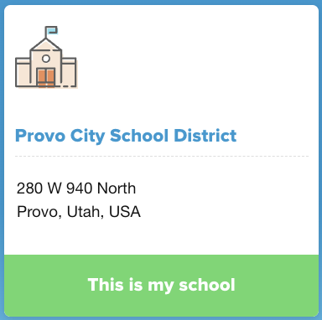
How do I get started with Sora?
Download the app on your personal device or go to the Sora icon on your school Chromebook.
Click on “Find my school”.
Type and Select Provo City School District.
Login with your Google account.

Slide 3
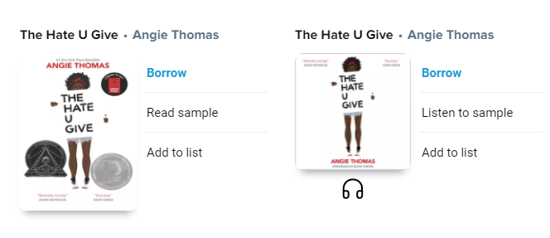
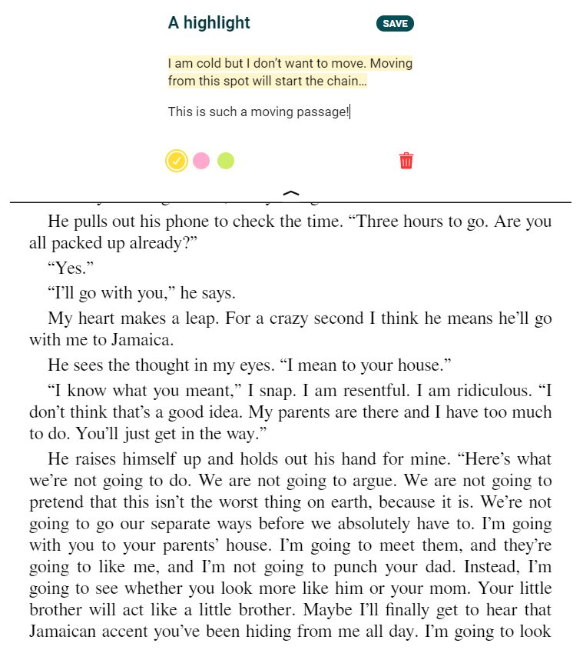
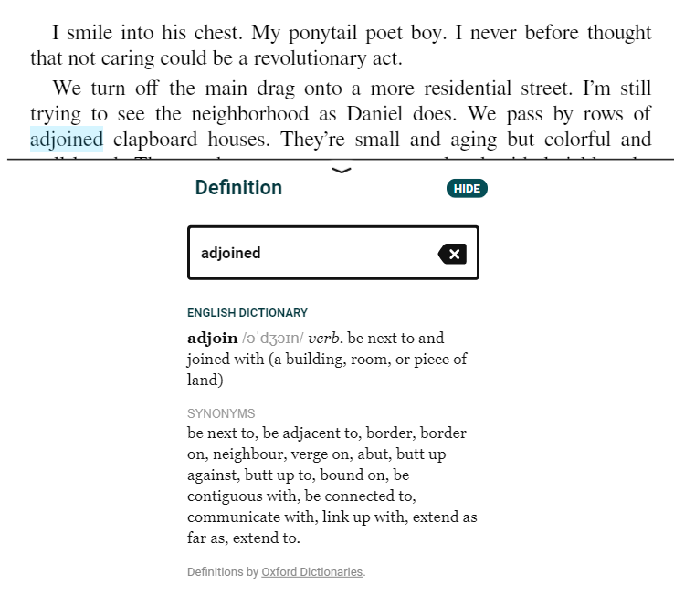
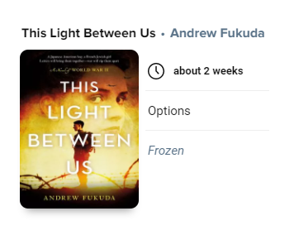
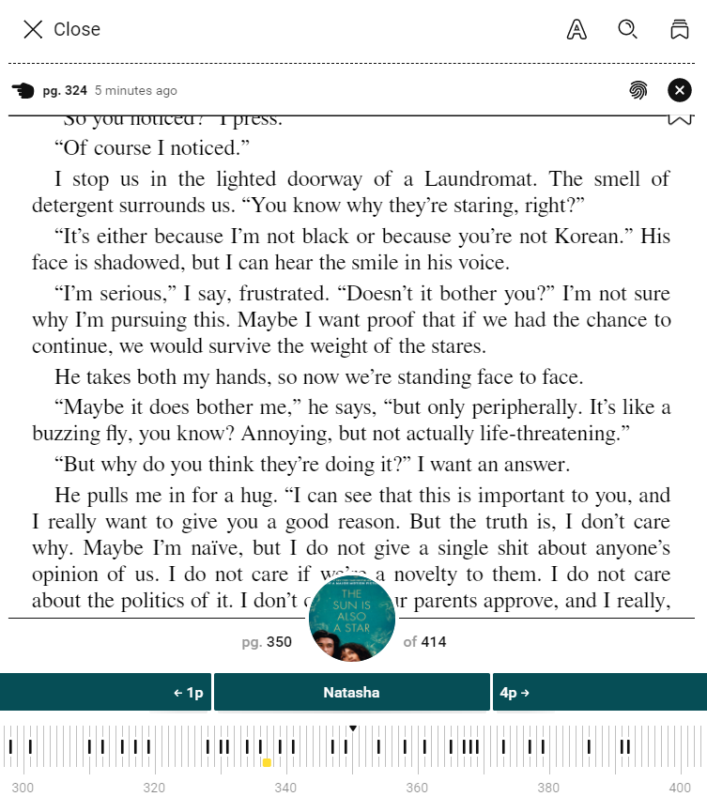
What can you do in Sora?
Read ebooks and listen to audiobooks.
Adjust reading or audio settings.
View and sync progress.
Define new or unfamiliar words.
Add and export bookmarks, highlights, and notes.
Place books on hold.
Add a public library for more books.

Slide 4
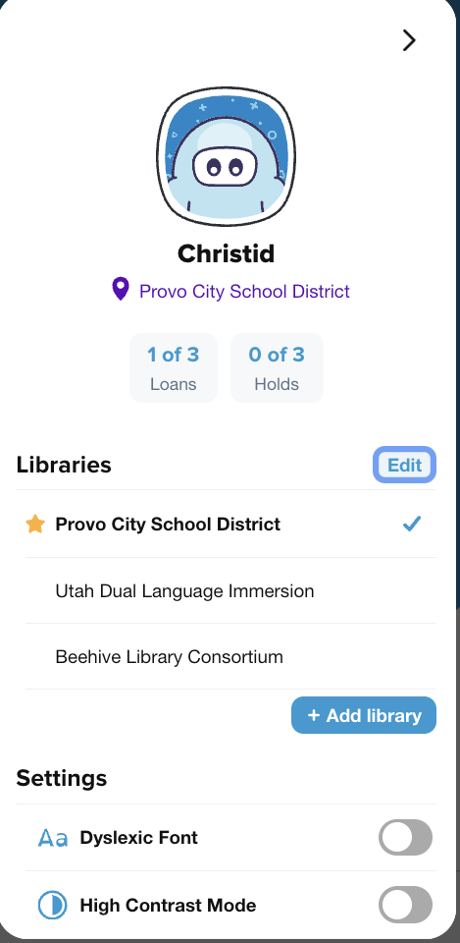
Provo City School District
Utah Dual Language Immersion
Beehive Library Consortium
Libraries You Can Access!

Slide 5
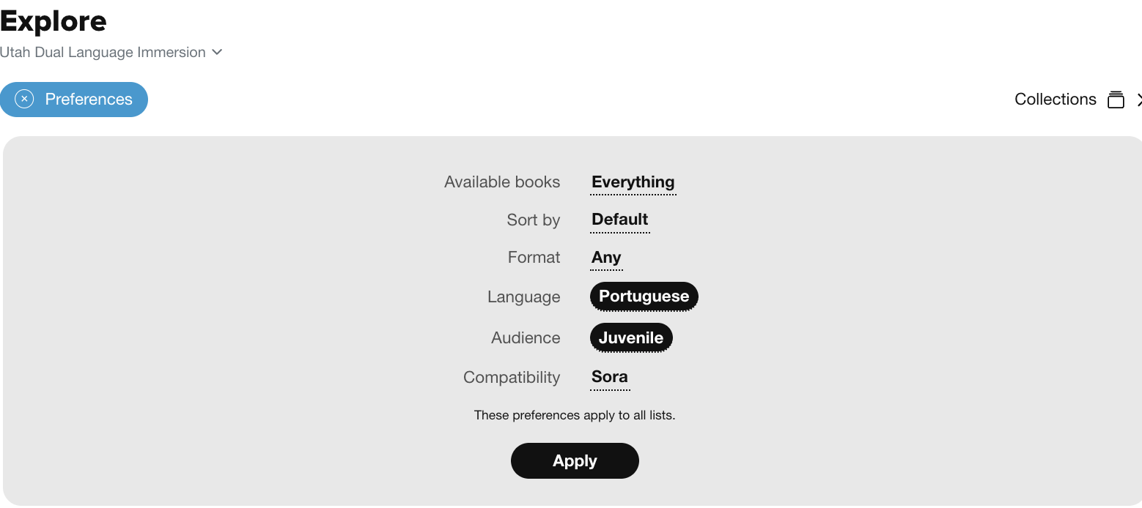
You Can Change Your Preferences in “Explore”!
Different languages including Portuguese titles are available when you choose “Utah Dual Language Immersion” as your library.
Click on the “Preferences” button then the “Language” button. Select your language of choice for your eBooks or Audiobooks.
Remember to click on “Apply” to save any changes you made in preferences.

Slide 6
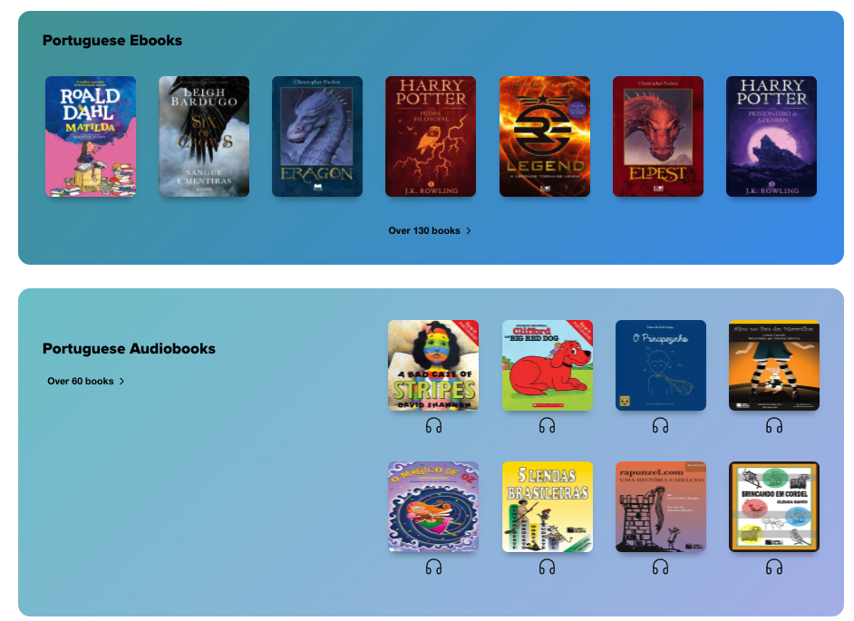

Slide 7
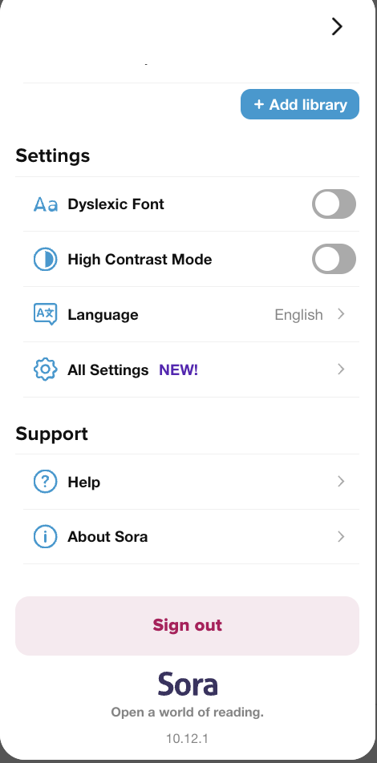
You Can Manage Your Settings!

Slide 8
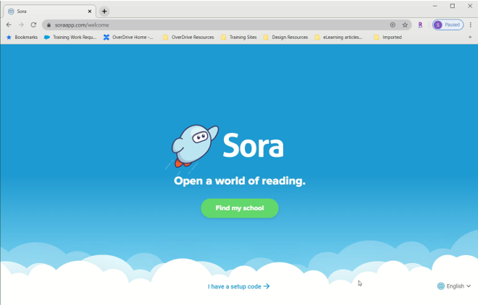
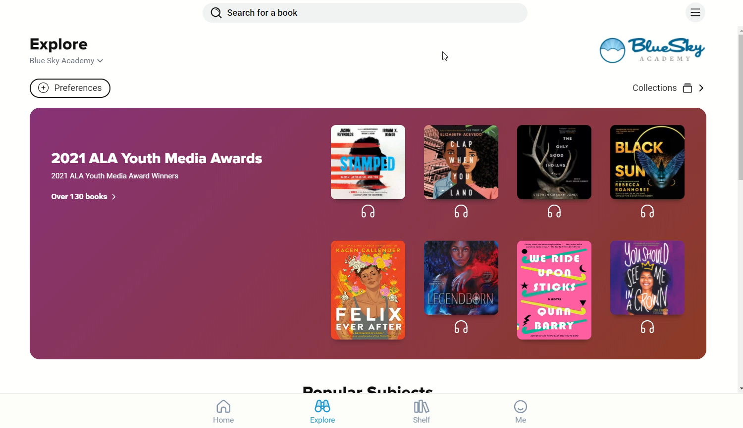
Find a book, borrow, and read! (Or listen!)

Slide 9
Soar With Sora

